Slide 1
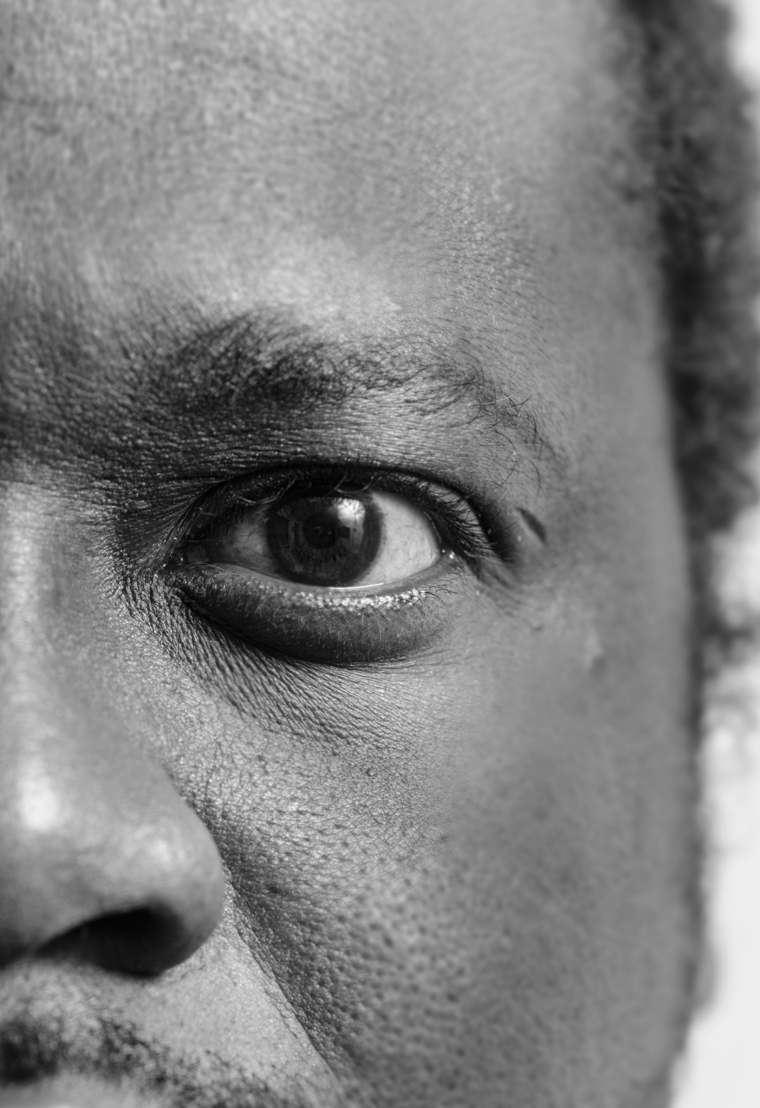
A brave new world; HIVST: Insights on Men and HIV Testing from South Africa
International AIDS Society 2018
Sunny Sharma
Ipsos Healthcare
24/07/18

Slide 2
No conflicts of interest to report
Relations that could be relevant for the meeting | Company names
Sponsorship or refund funds
Payment or other financial remuneration
Shareholder rights
Other relations

Slide 3
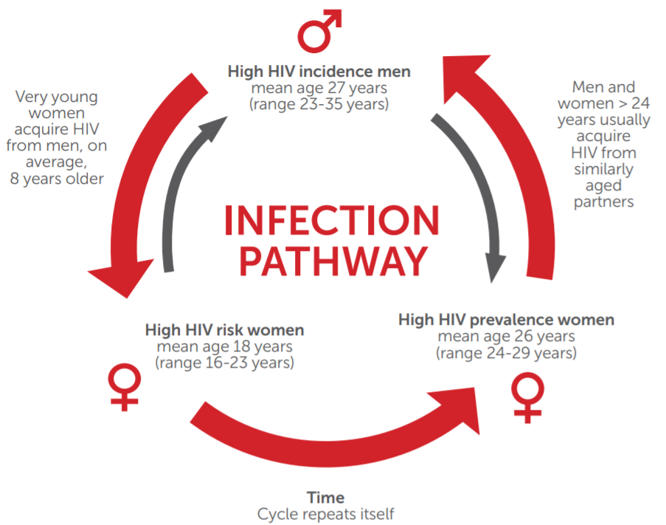
The Challenge: cycle of transmission

Slide 4
"We cannot solve the whole problem if we’re only addressing half the situation. If we want to win this fight, if we want to end AIDS once and for all, we must make men part of the solution.”
Sir Elton John IAS2018
24/07/18

Slide 5
South African young men project objectives;
A collaboration between Ipsos, Matchboxology and PSI to build approaches which:-
Get more men in high prevalence areas to test
Get the positives to link to treatment within 30 days
Project also assesses how we might get the negatives to link to prevention with a focus on oral PrEP

Slide 6
Whilst the project is not hivst specific, there are a number of observations with implications for hivst

Slide 7
Project phases
We are here
Ethnography:- Participant led observational method (n=18 men, 12 HIV-ve and 6 HIV +ve; n=4 HCWs))
Patient Pathways + Provider Archetyping:- Framing journeys through care systems (n=58 men;)
Segmentation:- Quantifying journeys and clustering different group pathways (n=2000 men)
Intervention design & pilot:- Human centred intervention design tailored to our target population needs
Qualitative Research
Quantitative Research
Human centred design
Model of behaviour change

Slide 8
What is daily life like for men living in some of the worst affected areas of Kwazulu Natal and Mpumalanga?

Slide 9
Daily life
Observational themes
Migration & Isolation
Learned helplessness
Overt & structural violence
Cognitive Dissonance
Stress &
Trauma

Slide 10
Men have few avenues to turn to for support. For some, a positive diagnosis marks the point of no return, a ‘loss of control’

Slide 11
There are many immediate costs to testing with no immediate rewards
Immediate costs
Immediate rewards
Positive diagnosis invites more stress into his life
Fear of more isolation after disclosing
Fear of loss of status amongst peers
Fear of implication on lifestyle
Fear of logistical and financial implications of longer term engagement with healthcare
If asymptomatic, treatment won’t bring any perceptible immediate benefits. In fact side effects may make it worse
Early treatment may increase his lifespan but he may not know this, or his knowledge may be vague
HIVST may not reach these men if we do not address the cost benefit calculus

Slide 12
Health system challenges
The implementation of UTT appears inconsistent.
Support for disclosure appears inadequate.
Privacy and confidentiality appears routinely violated

Slide 13
Takeaways and implications for HIVST
Men have a lot of stress in their lives. HIVST has a big opportunity to remove some of the stress of testing by giving men privacy, discretion and control!
HIVST gives men opportunities. We can be smart around understanding where and how to reach them
However, HIVST is delivered within a larger health system and whilst it can address some of the barriers to testing (esp. discretion and giving control), it does not necessarily address disclosure or privacy concerns over ART/ challenges in linkage
Programming for HIVST should address the broader health system concerns with a focus on linkage
For example, campaigns can be built to support men with disclosure and to educate on U=U

Slide 14
Thank you sunny.sharma@Ipsos.com (Insight lead) smalone@psi.org (Project director) paris@matchboxology.com (Intervention designer)

